Slide 1
Latency vs. No latency model
Based on India settings
Date: Feb 5, 2024

Slide 2
Parameter analysis
Identify disease progression mechanism and parameter groups

Slide 3
HPV Progression with latency in a genotype
dur_infection
transmission prob
transf2m, rel_beta, rel_sus, immunity
sexual behavior (layer_probs, cross_layer, acts, dur_pship, age_act_pars, condoms)
dur_cin
age_risk
dur_cin
dur_precin
cin_probs
cin_fn
dur_precin
rel_sev (sev_dist)
cancer_probs
cancer_fn
dur_cin
rel_sev (sev_dist)
Susceptible
/w. immunity
Infected
HSIL
Cancer
Clears Infection
Immunity
Vaccine
cross_immunity, own_imm_hr
Cleared infection - imm_init, cell_imm_init, vaccine
Clears Infection
hpv_control_prob
At the end of dur_precin,
individuals proceed to cin or clears infection. If clears infection, become latent w.p. hpv_control_prob
=> with High control_prob and low reactivation, most of cleared infections are latent, never proceed to hsil/cancer?
reactivation
hpv_reactivation
sev_imm (cross_immunity_sev)
hiv
Latent infection
(Not infectious/susceptible)
Notes:
Q) How does this structural difference impact calibration parameters to fit the data?

Slide 4
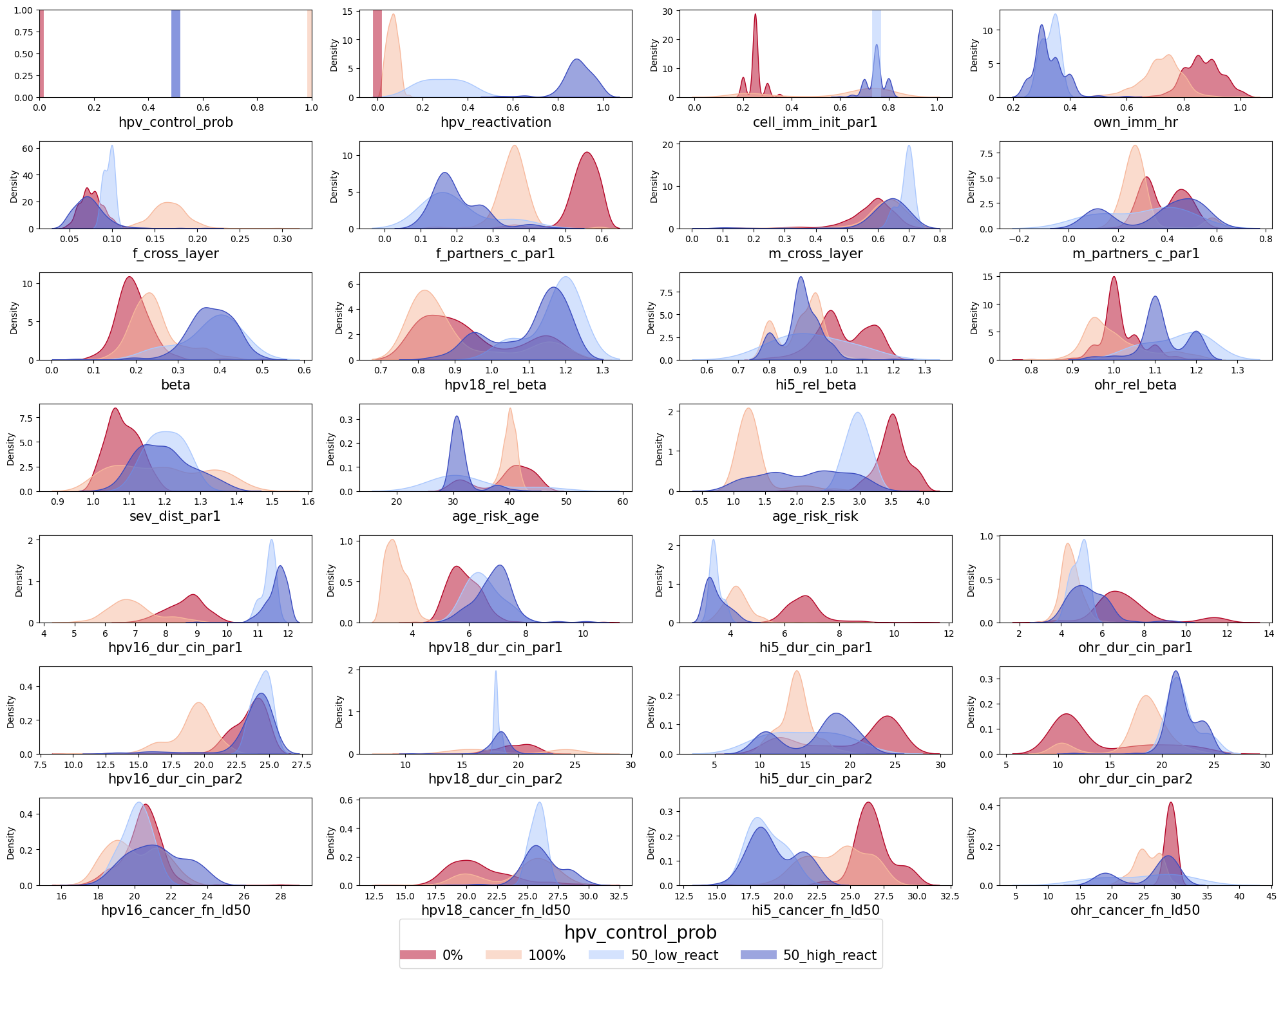
Parameter settings
Current group:
0% latency
50% latency but low reactivation
50% latency but high reactivation
100% latency
Recommendations – Reduce number of calibration parameters to explain input-ouput relations more easily. Consider parameter importance and correlations (available in later sections). Maybe pick 1 to 2 parameters for each section.
Sexual behavior – f_cross_layer (or f_partners_c_par1)
Reinfection related - hpv_control_prob and hpv_reactivation
Immunity related – cell_imm_init_par1 (or own_imm_hr)
Disease severity related – sev_dist_par1 (or dur_cin_par1), age_risk_risk
If the mismatch score is not satisfying, include more aprameters

Slide 5
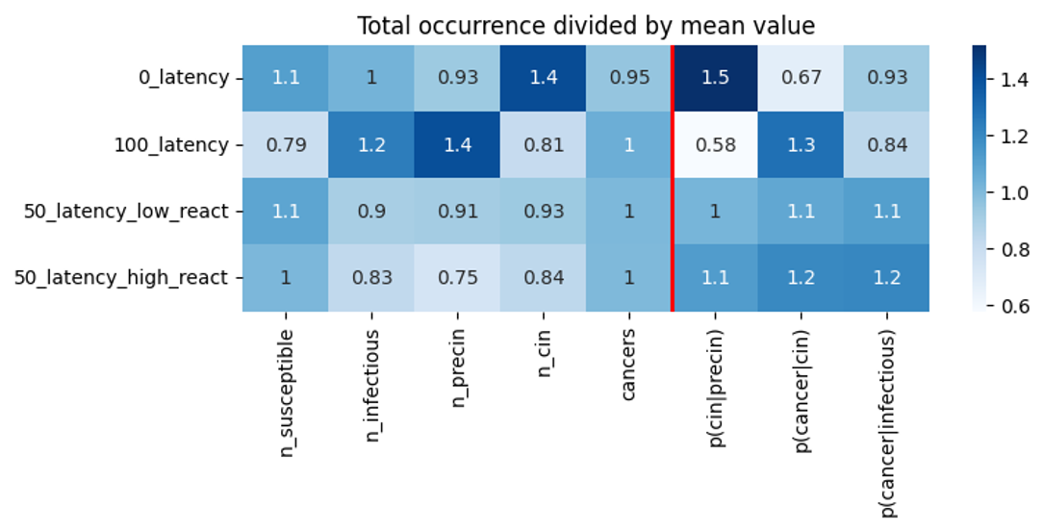
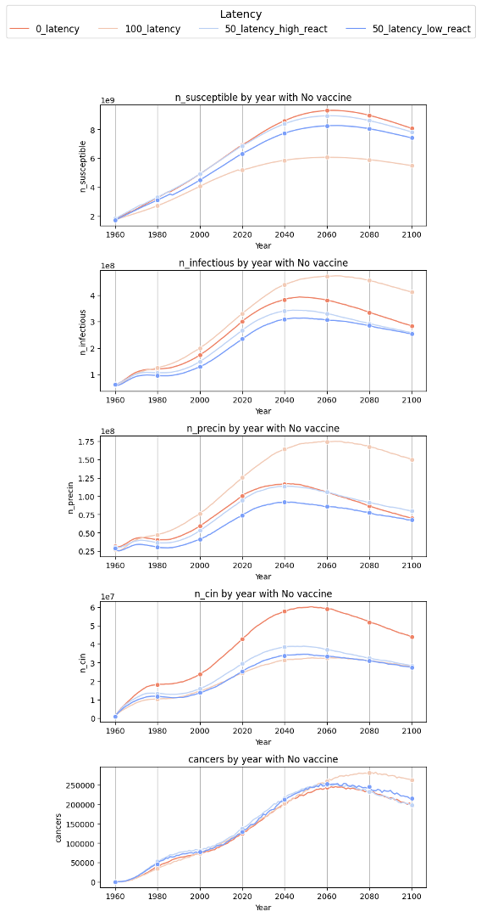
Disease progression without vaccine
0% latency has high probability of precin to cin but has low cancer risk when in cin – due to sev_dist or age_risk_risk?
100% latency has low probability of going to cin when infected but once in cin, high cancer risk
50% latency - high reactivation has overall high disease progresison risk once infected.
Recommendations
Understand different disease progression status by group. See how vaccine changes each status
Look at results by age or by genotype results if needed

Slide 6
Hypothesis on disease progression
With no latency, older age of causal infection, very long dwell time
With 100 latency, earlier age of causal infection
With 100 latency, more infections, dormant, but because more active infections, vaccines are helpful
100 latency has higher f_cross_layer, lower f/m_c_par1
With 50 latency and high reactivation, lower hpv infections, so less benefits of vaccines
=> Check if these are correct

Slide 7
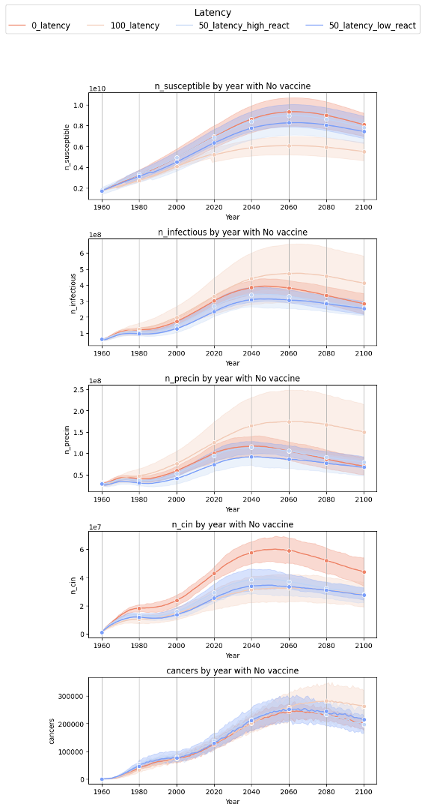
More results - Disease progression with intervals
n_infectious and n_precin has high uncertainty with 100% latency model -> why?

Slide 8
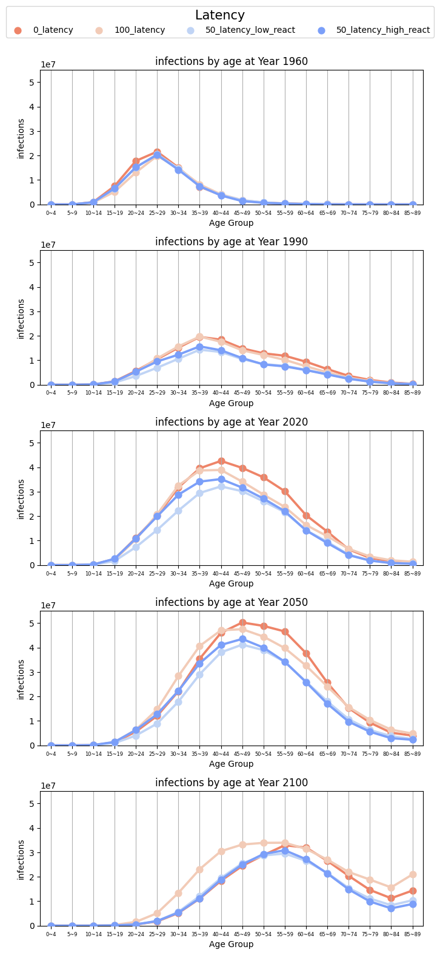
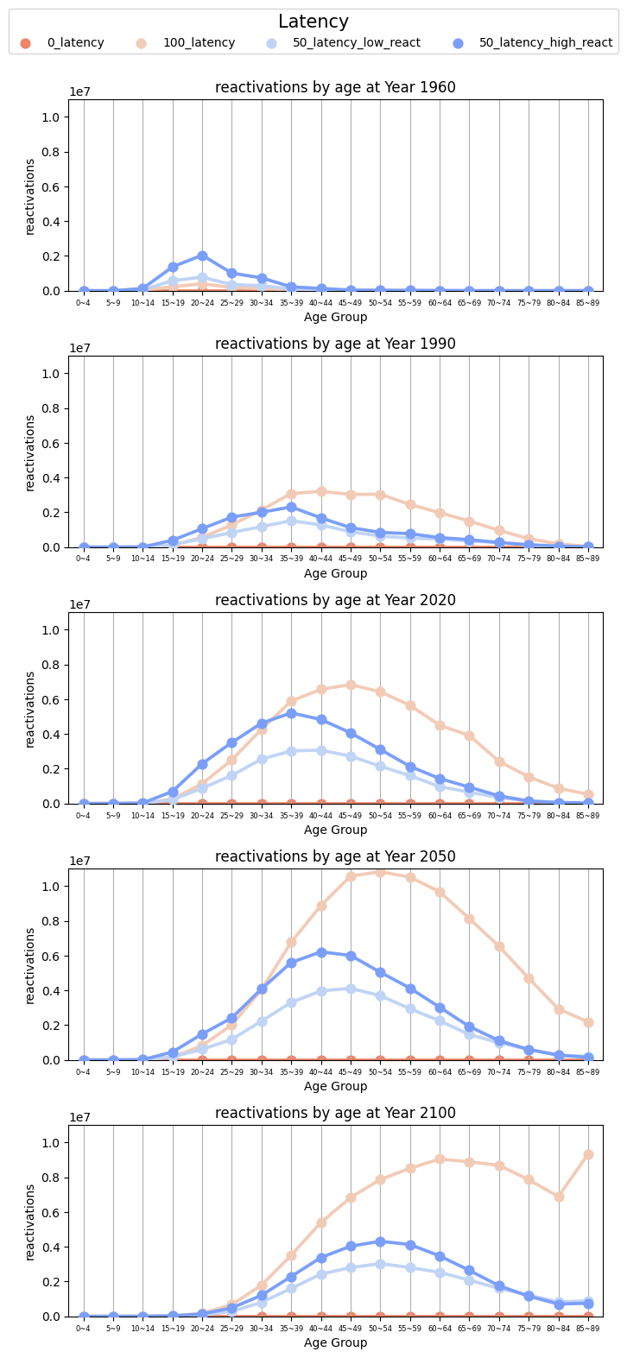
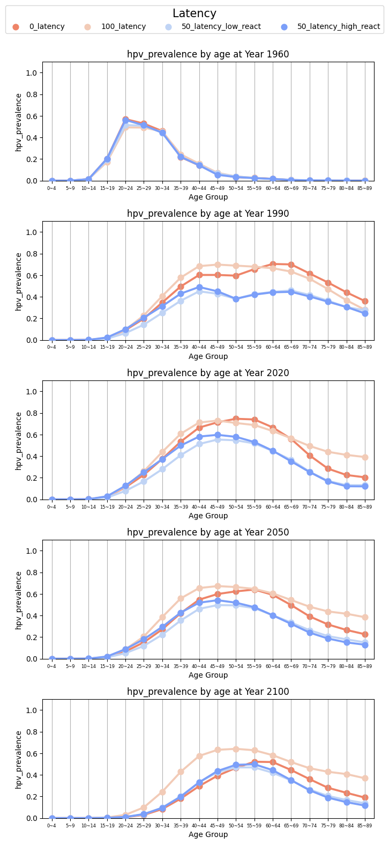
More infection-related results by age and year without vaccination

Slide 9
Policy analysis
Run policy outcomes with selected parameter settings
Policy question – should we expand the vaccination age to older groups?

Slide 10
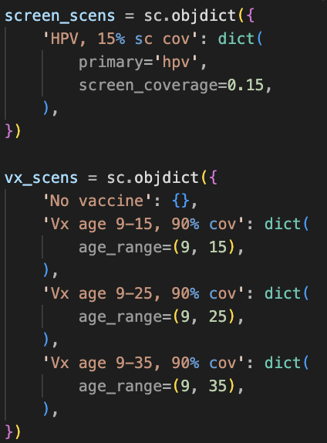
Policy scenario settings
For each group, use top 10 parameter sets. Because 50%-low reactivation setting’s mismatch score was not good, selected top 5 with 50%_low react.
Run with 1 seed (due to computation limits)
Baseline: 15% HPV screening coverage and No vaccine
Vaccine eligibility: From age 9 to age 15, 25, 35
90% vaccine coverage

Slide 11
Total cancer averted
Averted cancers : 0% > 100% > 50% with low reactivation > 50% with high reactivation
Most benefit when moving from No -> age (9,15)
Same trends observed in asr_cancer_incidence and cancer_deaths

Slide 12
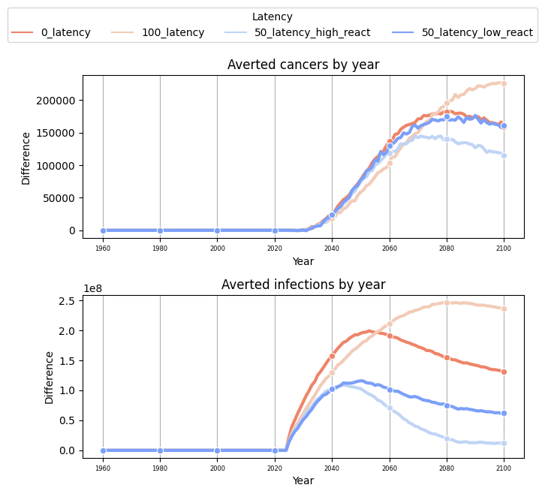
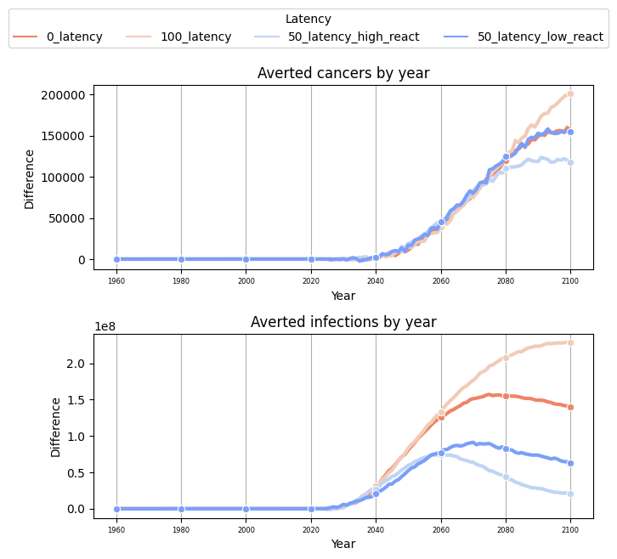
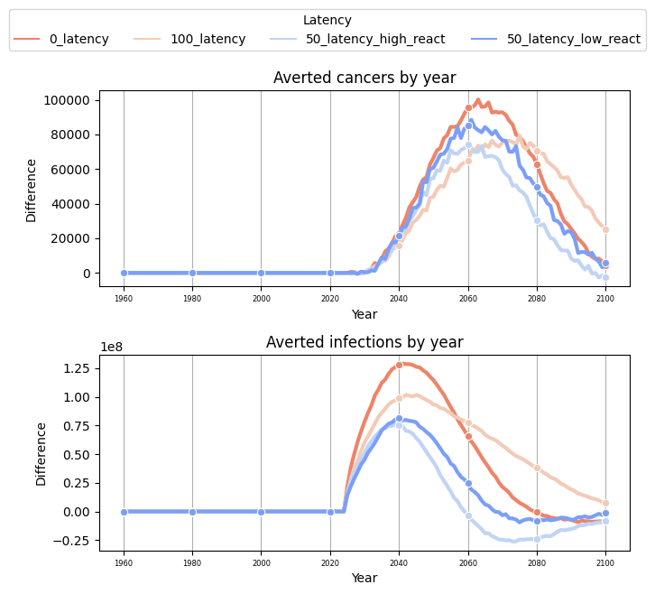
Cancer averted by year (No => vaccinate until 35)
100 latency benefits later
50 latency with high reactivation has constantly lowest benefits
No vaccine -> age 15
Age 15 -> age 35
With high reactivation,
age expansion may delay infections,
reducing vaccine effects

Slide 13
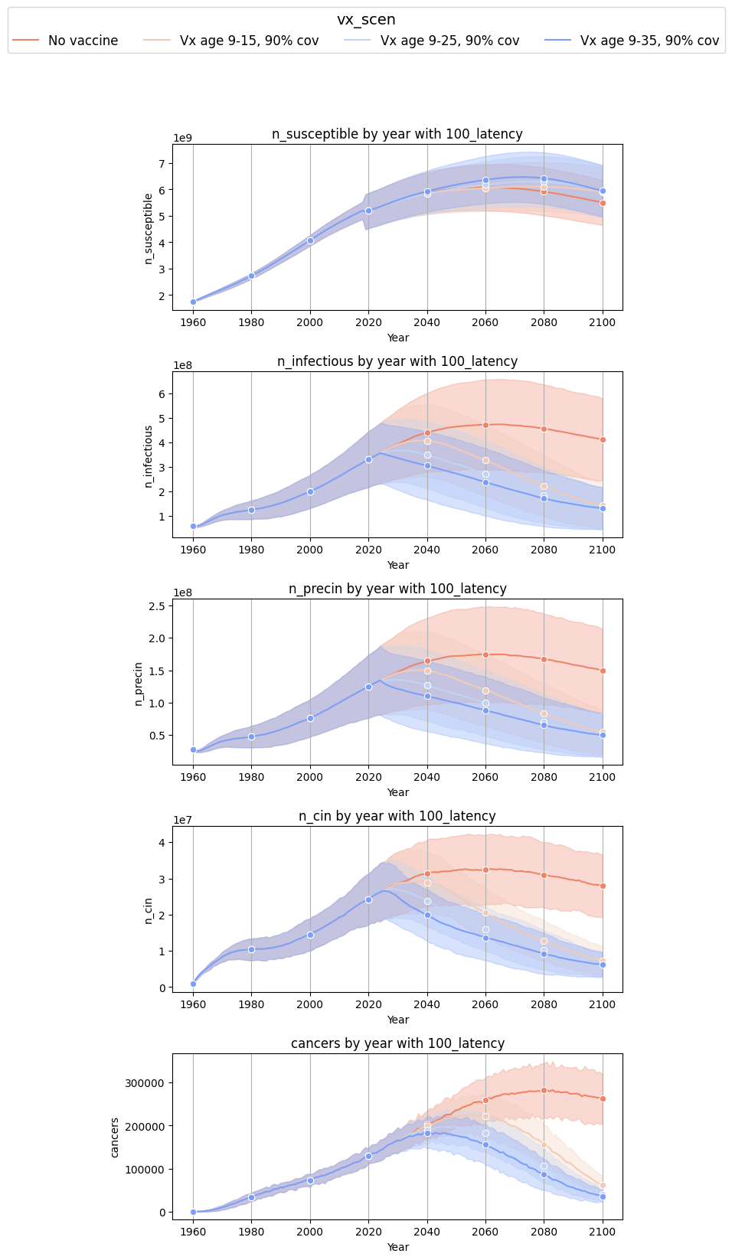
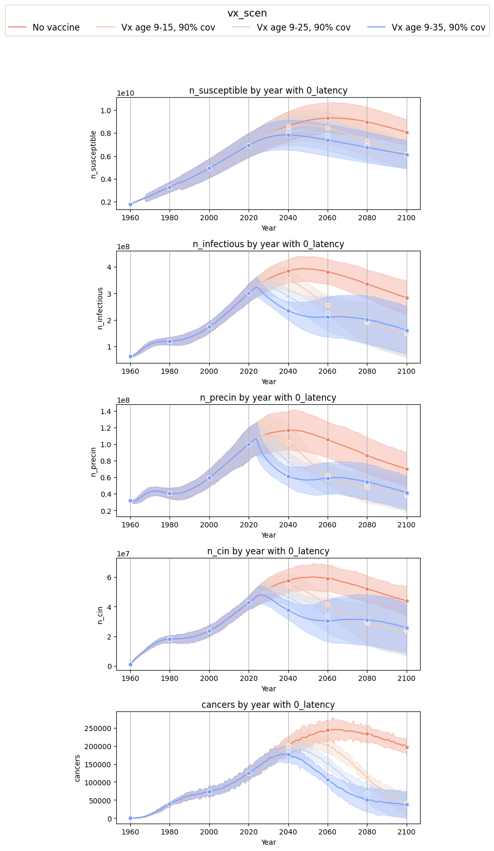
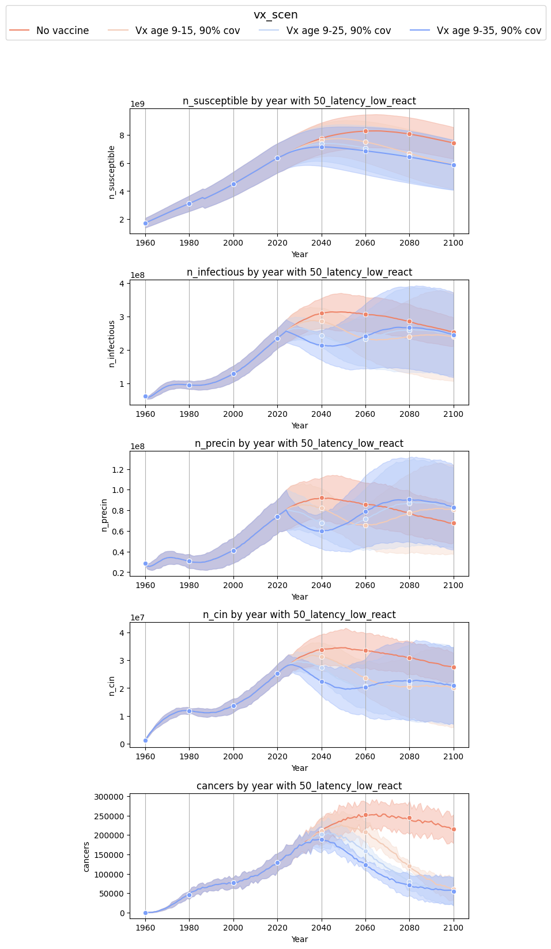
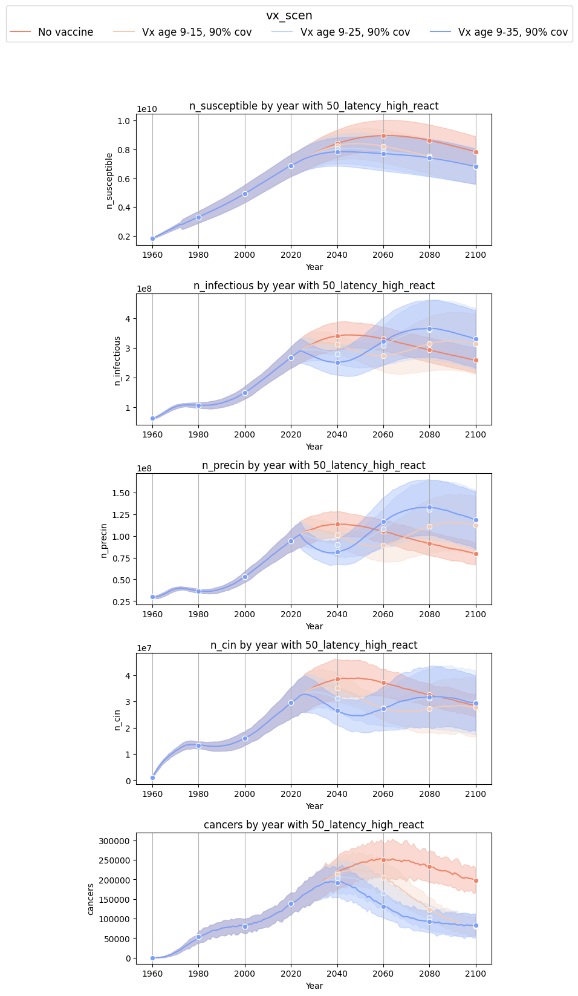
More policy outcomes by disease status
50% latency, low reactivation
50% latency, high reactivation
0% latency
100% latency
Vaccination always helps.
However, with high latency, expanding vaccination age doesn’t have clear effects (overlapping bounds)
In 50% latency model, even with reactivated infections, causing n_cin increase, cancer still decreases –why? because it takes time from cin to cancer? if we simulate longer, will we observe increase in cancers?

Slide 14
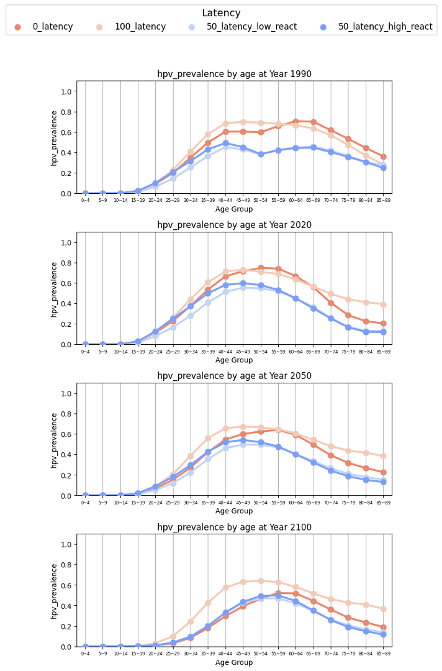
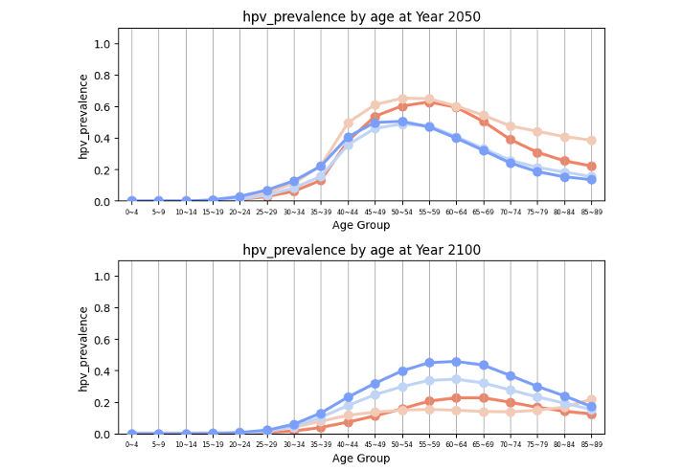
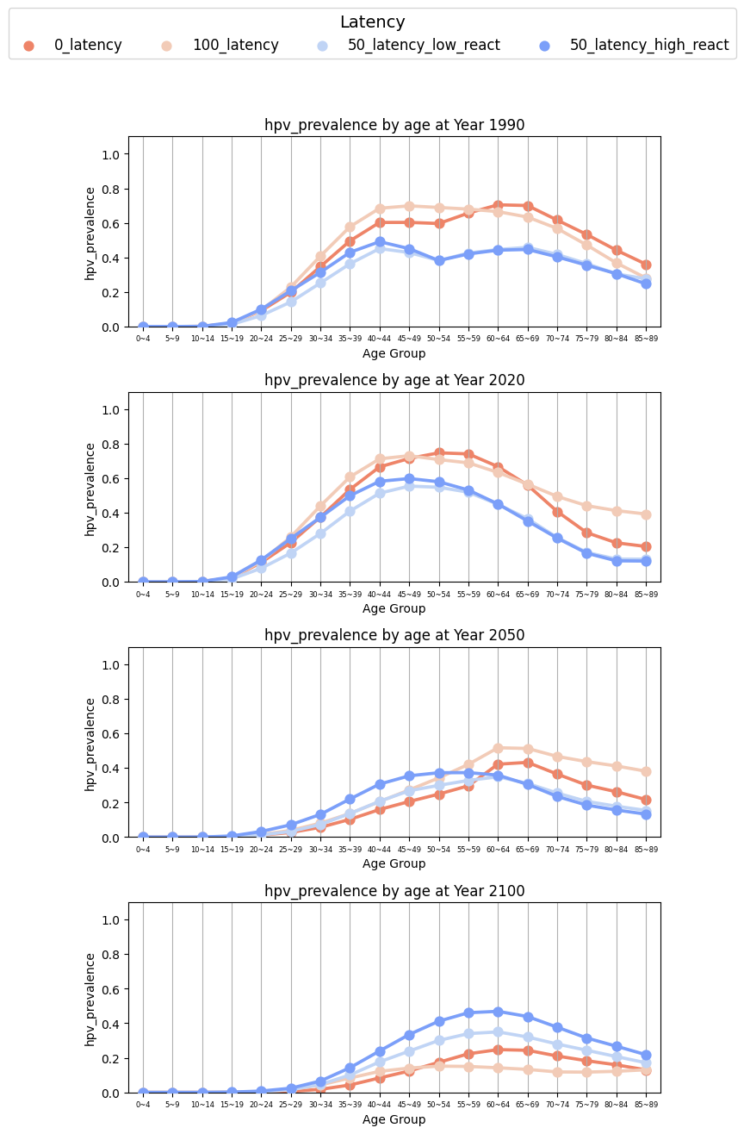
More results on HPV prevalence by age and year
50% latency models reduce hpv prevalence in younger age at 2050 but many are reactivated at 2100. expanding to age 35 does not benefit at year 2100.
100% sees dramatic reduction at year 2100 – takes time but ultimately beneficial, due to more latent infections.
No vaccine
Age 15
Age 35

Slide 15
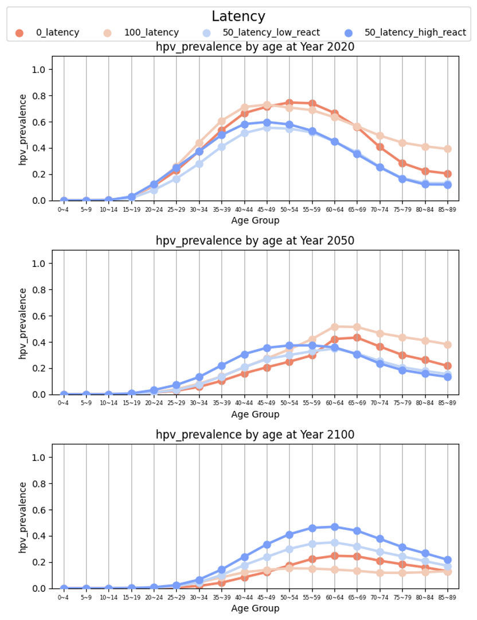
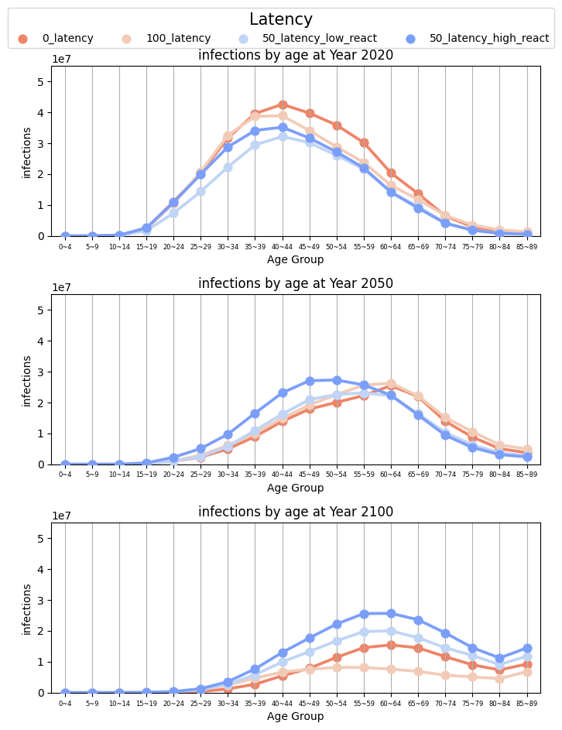
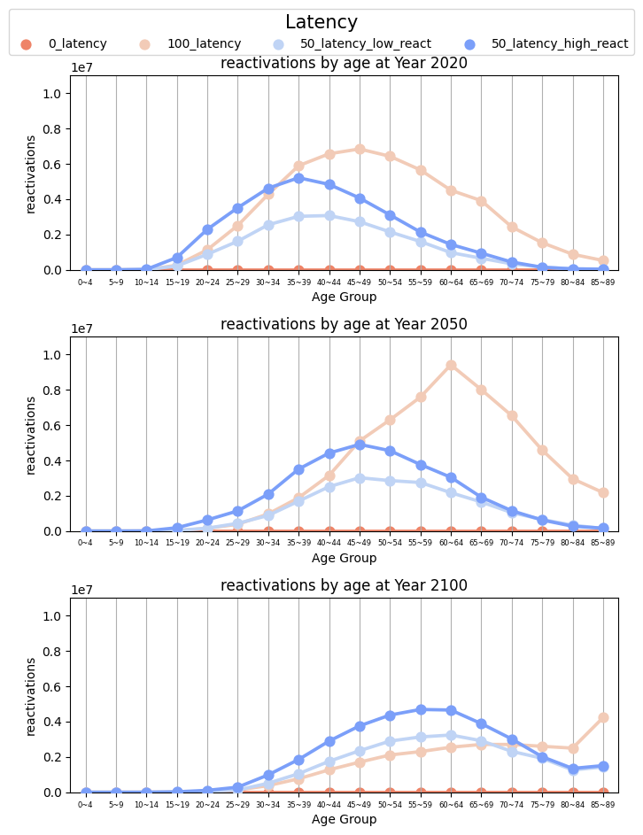
More HPV infections related results with most vaccination (age 9 to 35)

Slide 16
Parameter analysis
Identify key parameters and parameter relations

Slide 17
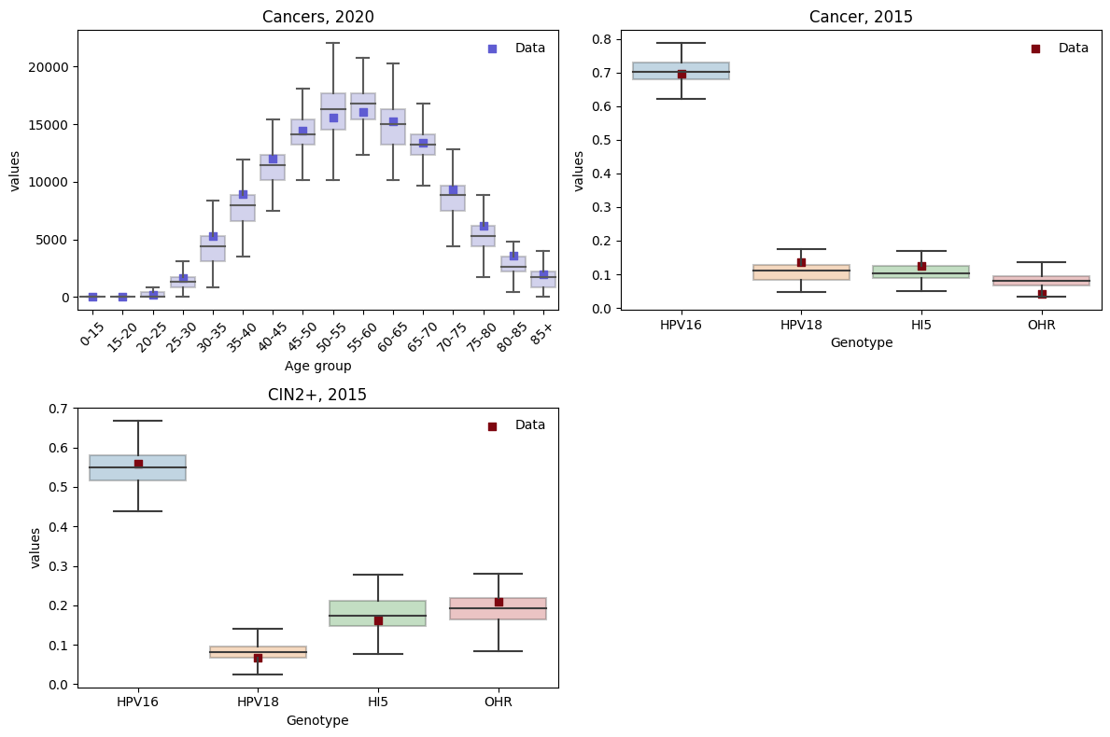
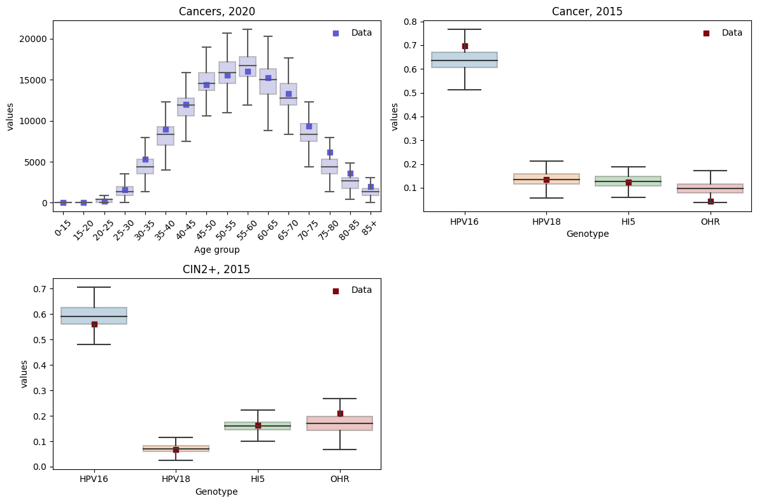
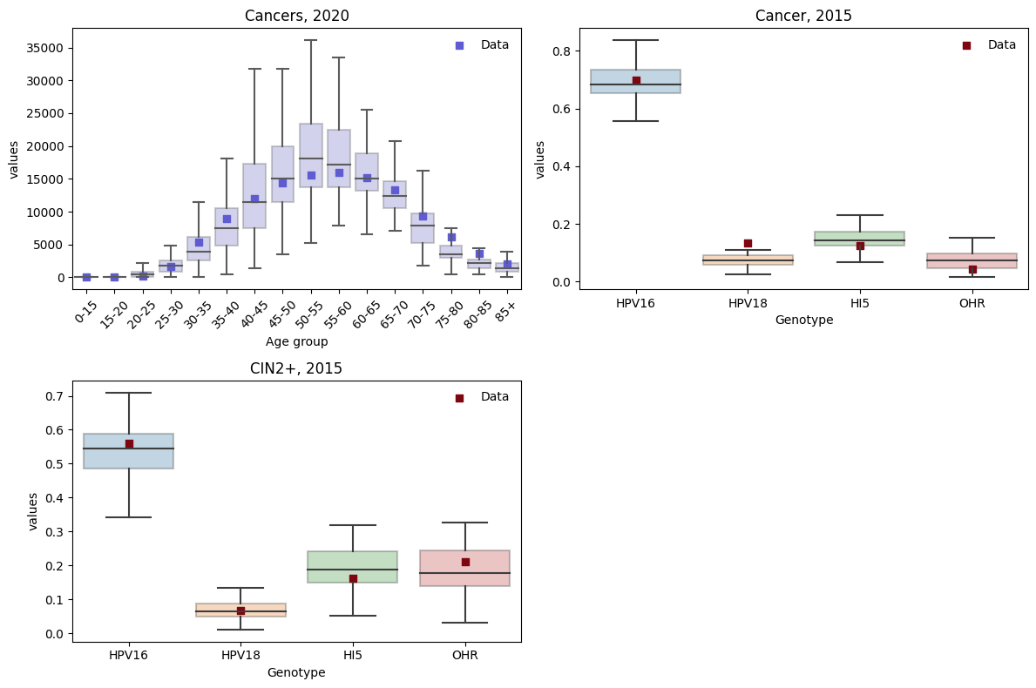
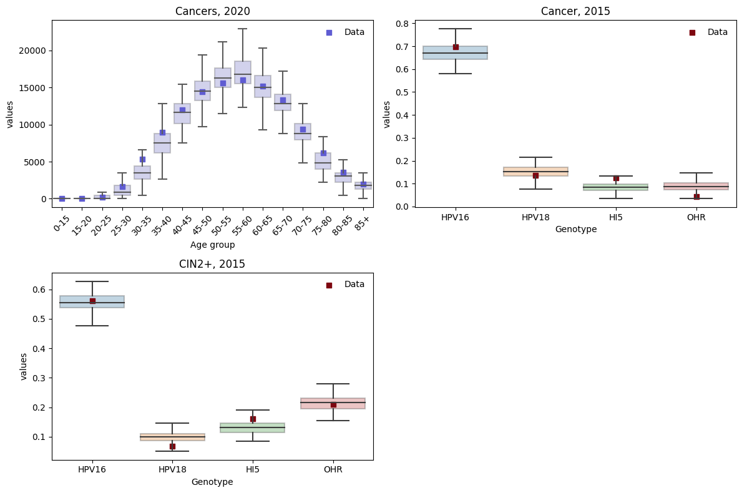
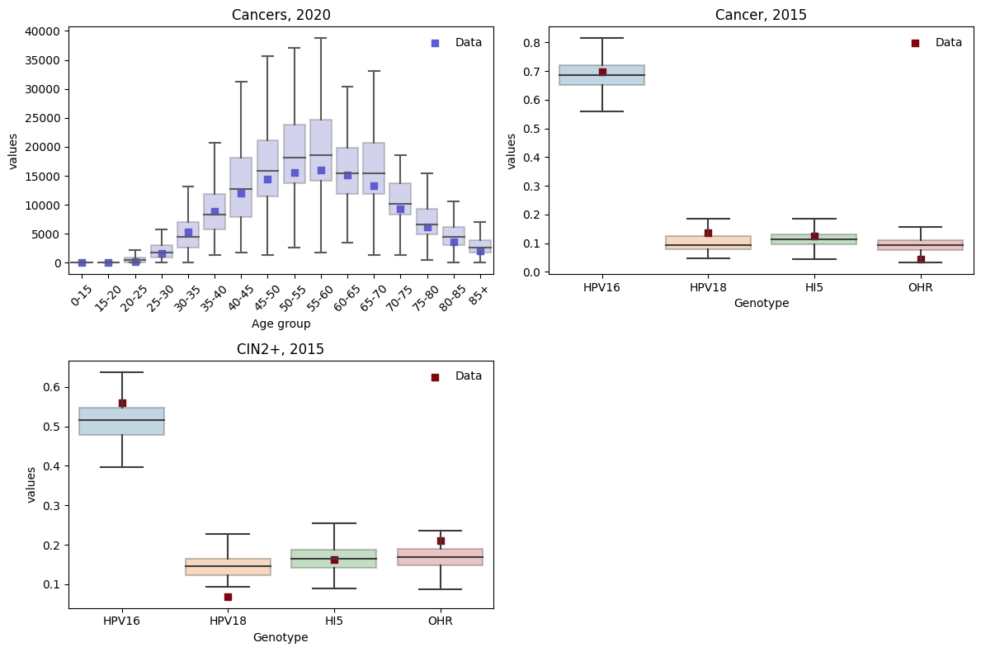
Calibration outcomes with mismatch < 1.8
hpv_control_prob = probability of HPV infection progressing to latency
# parameter sets < 1.8 (Total: 603)
0%
(No latency)
125 parameter sets
179 parameter sets
25%
72 parameter sets
50%
150 parameter sets
75%
100%
(All cleared infection is latent)
149 parameter sets
Notes:
Caution!! analyzer is not initialized when loop over run_calibration. Completely start again when changing settings

Slide 18
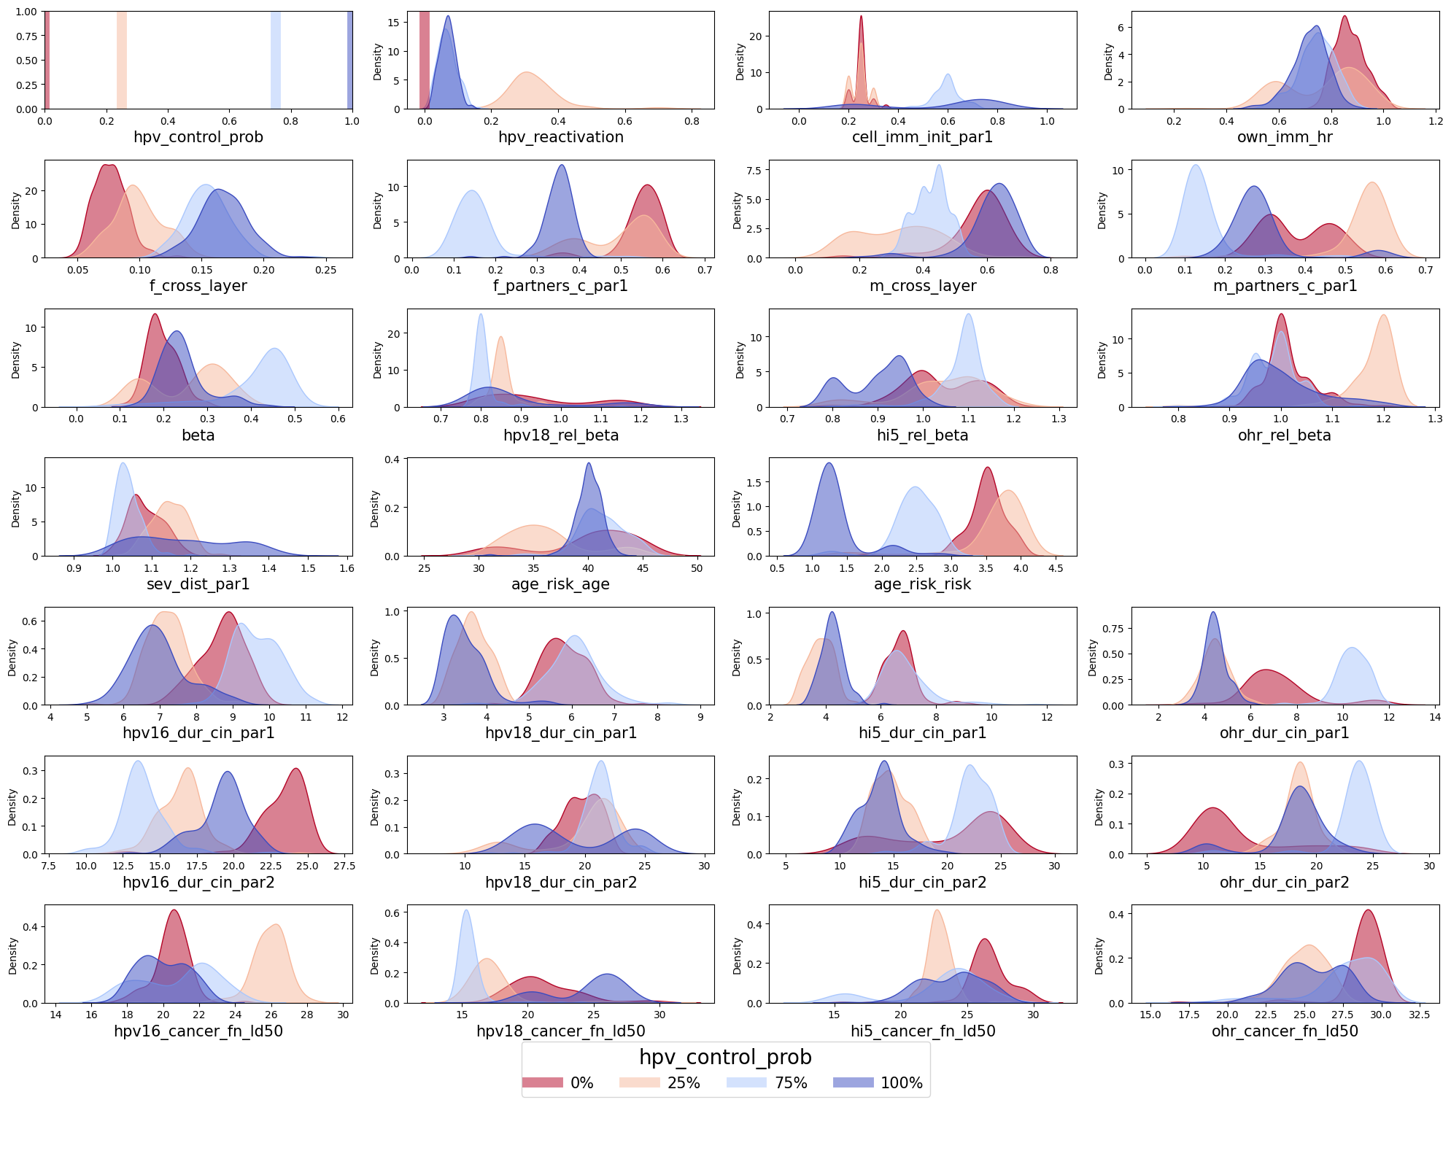
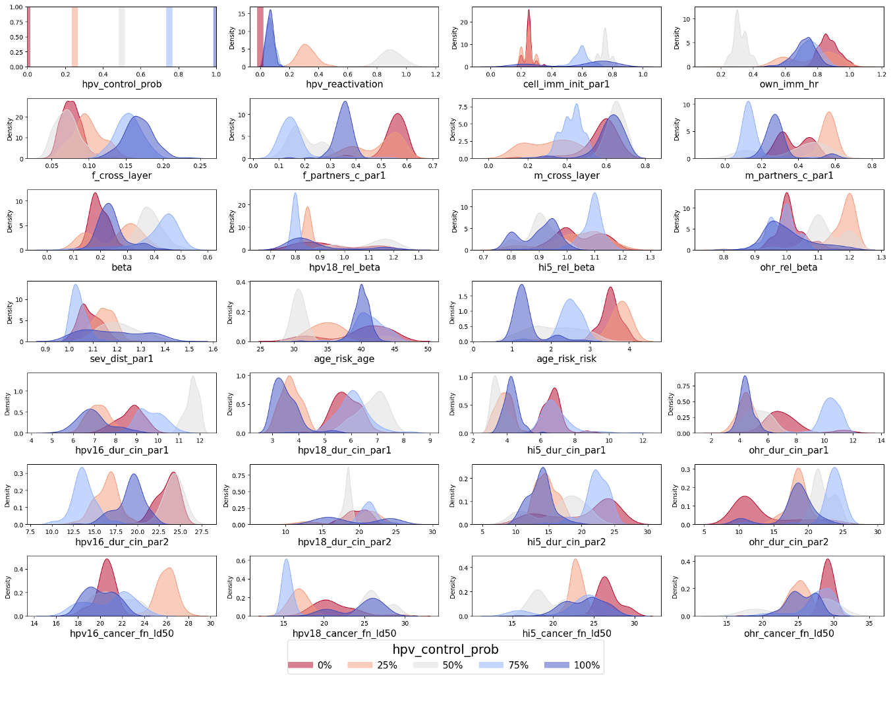
Top parameter sets distributions
Parameters usually stays at one region
Some parameters show clear trends related to hpv_control_prob level
Next slides identify key parameters and parameter relations

Slide 19
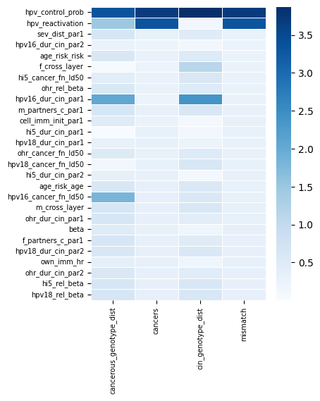
Parameter importance and relations
Identify key parameters by fitting linear regression to outcomes with all calibration results (32,000 points)

Slide 20
Parameter importance and relations
Identify parameter relations from good parameter sets (603 points) using correlation function, starting from key parameters
Highly correlated parameters (>0.7)
According to google …
0.7~0.9: high correlation
0.5~0.7: moderate correlation

Slide 21
Parameter relations to hpv_control_prob
High latency (hpv_control_prob) is positively correlated with
high f_cross_layer
high cell_imm_init_par1
High latency (hpv_control_prob) is negatively correlated with
low age_risk_risk
low hpv_reactivation
low f_partners_c
low m_partners_c
Interpretation
These seven parameters correlate to each other. All are infection related parameters except for age_risk_risk that impacts dur_cin
Parameters balance each other to fit data
Sexual behavior: f_cross_layer <->f_partners_c, m_partners_c
Immunity parameters: cell_imm_init, hpv_control_prob <-> hpv_reactivation
param1 | param2 | Correlation score
hpv_control_prob | f_cross_layer | 0.89
hpv_control_prob | cell_imm_init_par1 | 0.75
hpv_control_prob | m_partners_c_par1 | -0.57
hpv_control_prob | f_partners_c_par1 | -0.69
hpv_control_prob | hpv_reactivation | -0.85
hpv_control_prob | age_risk_risk | -0.86
f_cross_layer | cell_imm_init_par1 | 0.72
m_partners_c_par1 | f_partners_c_par1 | 0.71
hpv_reactivation | f_partners_c_par1 | 0.68
hpv_reactivation | age_risk_risk | 0.59
f_partners_c_par1 | age_risk_risk | 0.51
m_partners_c_par1 | age_risk_risk | 0.50
m_partners_c_par1 | hpv_reactivation | 0.34
m_partners_c_par1 | f_cross_layer | -0.55
m_partners_c_par1 | cell_imm_init_par1 | -0.57
hpv_reactivation | cell_imm_init_par1 | -0.60
cell_imm_init_par1 | age_risk_risk | -0.63
f_partners_c_par1 | cell_imm_init_par1 | -0.63
f_partners_c_par1 | f_cross_layer | -0.66
f_cross_layer | age_risk_risk | -0.74
hpv_reactivation | f_cross_layer | -0.78

Slide 22
Parameter relations to sev_dist_par1
High severity (sev_dist_par1) is negatively correlated to
low hpv16_dur_cin_par1
low hpv18_dur_cin_par1
low ohr_dur_cin_par1
low hi5_dur_cin_par1
dur_cin_par1 are highly positvely correlated across genotypes
Interpretation
Severity and dur_cin balance to fit data
Consider using single parameter for dur_cin_par1
param1 | param2 | Correlation score
hpv16_dur_cin_par1 | sev_dist_par1 | -0.68
hpv18_dur_cin_par1 | sev_dist_par1 | -0.58
ohr_dur_cin_par1 | sev_dist_par1 | -0.56
hi5_dur_cin_par1 | sev_dist_par1 | -0.52
param1 | param2 | Correlation score
hi5_dur_cin_par1 | hpv18_dur_cin_par1 | 0.83
hpv16_dur_cin_par1 | hpv18_dur_cin_par1 | 0.81
hi5_dur_cin_par1 | ohr_dur_cin_par1 | 0.79
hpv18_dur_cin_par1 | ohr_dur_cin_par1 | 0.79
hpv16_dur_cin_par1 | ohr_dur_cin_par1 | 0.77
hi5_dur_cin_par1 | hpv16_dur_cin_par1 | 0.75

Slide 23
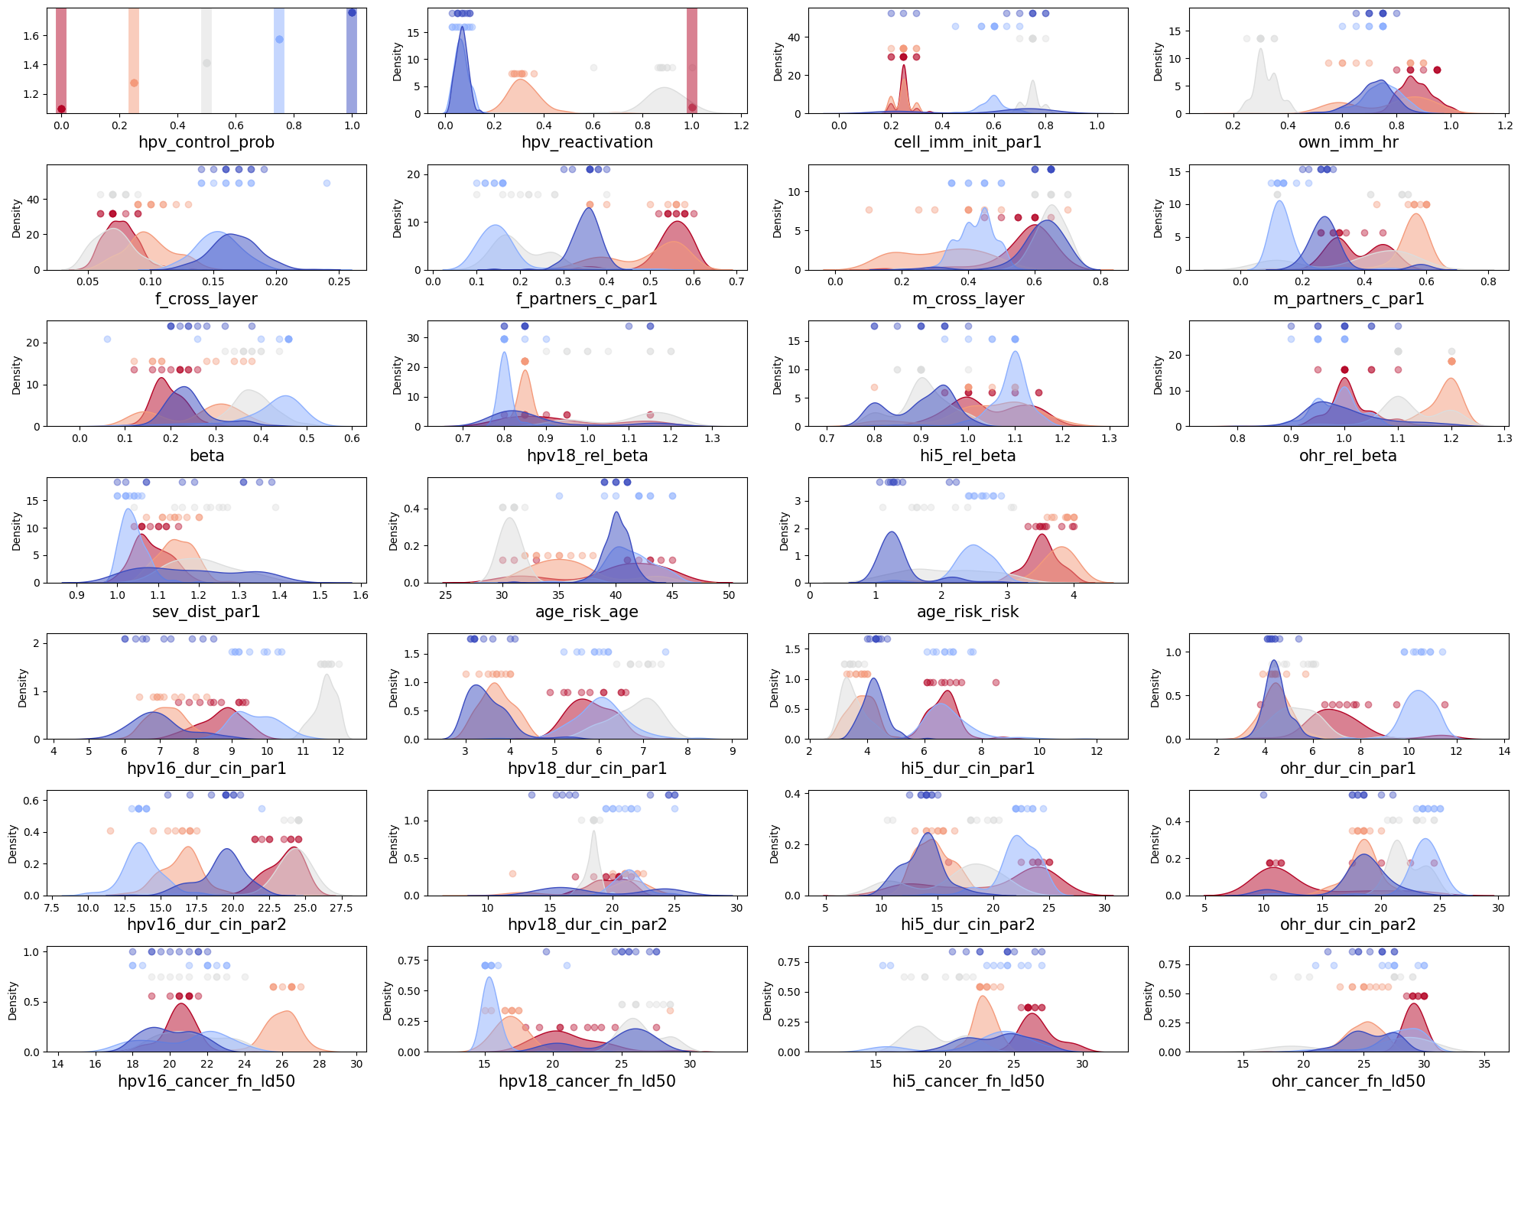
Adding 50% hpv_control_prob
Given 50% latent infections, high vs. low reactivation - Low f_cross_layer
Given high reactivation (>0.5),
50% vs. 100% latent infection
Given 50% latent infection - high

Slide 24
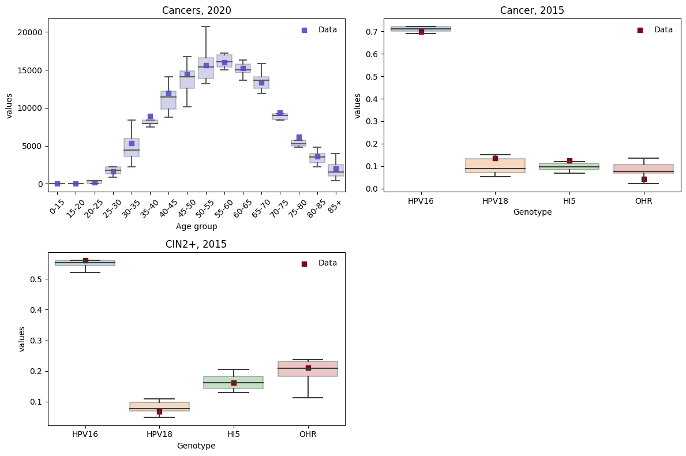
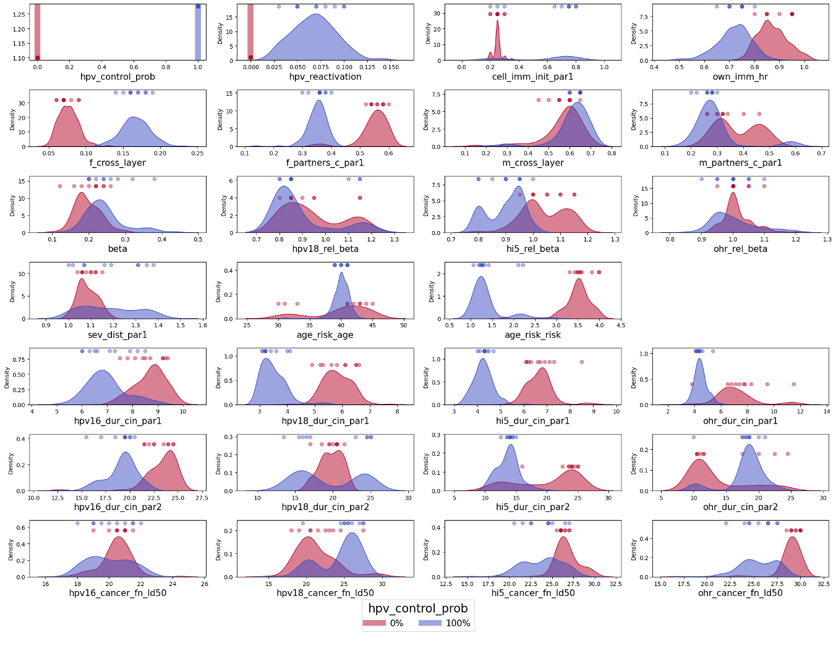
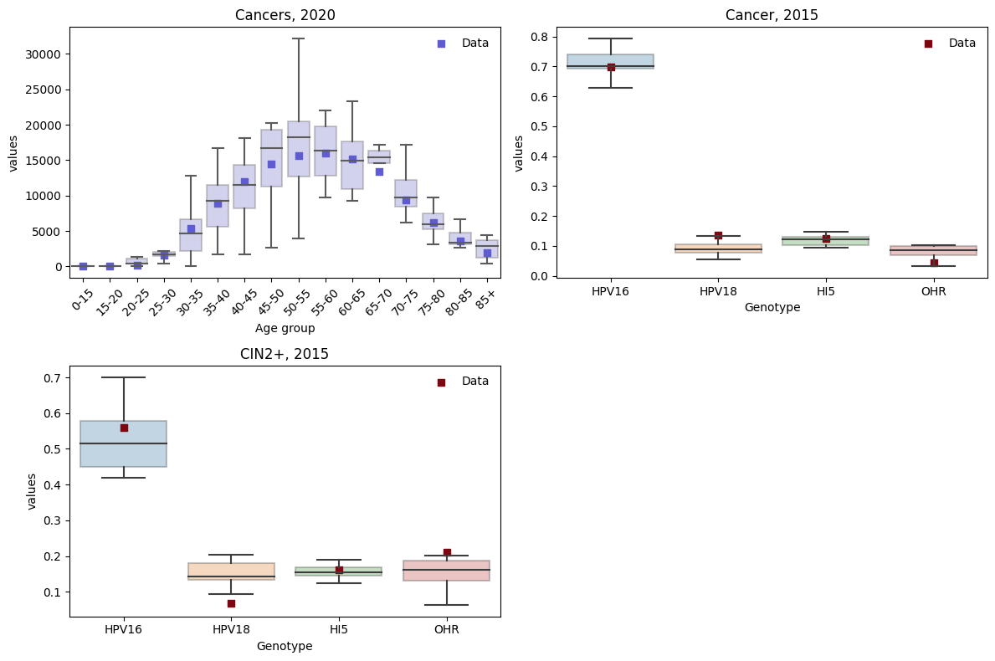
Parameter settings with 0% vs. 100% latency
Top 10 parameter sets for each hpv_control_prob represent the parameter space farely well
To fit data, 100% latency is associated with
Low hpv_reactivation
High cell_imm_init vs. Low own_imm_hr
High f_cross_layer vs. Low f/m_c_par1
High sev_dist_par1 vs. Low age_risk_risk, dur_cin_par1
hpv_control_prob = 0 Top 10 param results
hpv_control_prob = 1 Top 10 param results

Slide 25
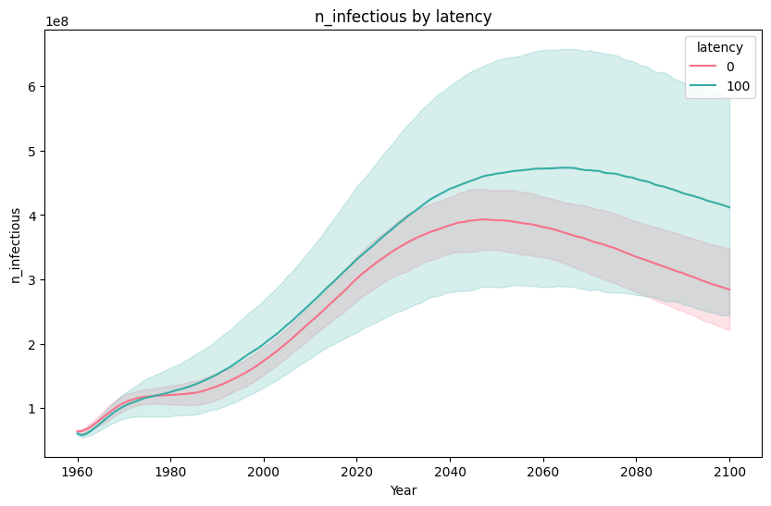
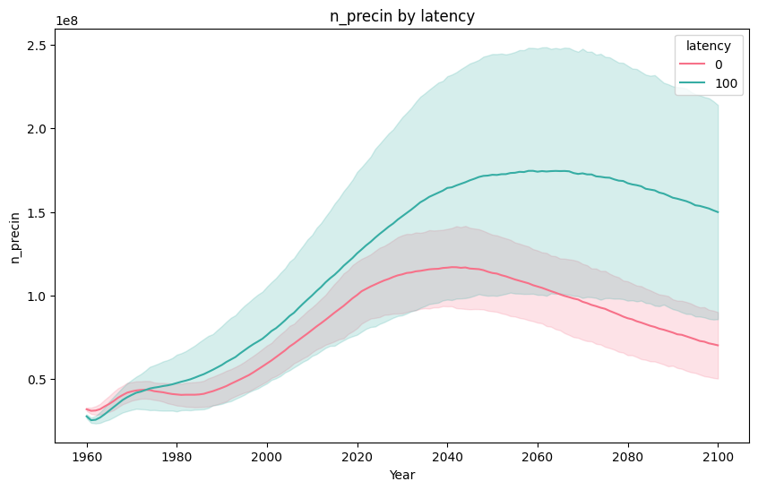
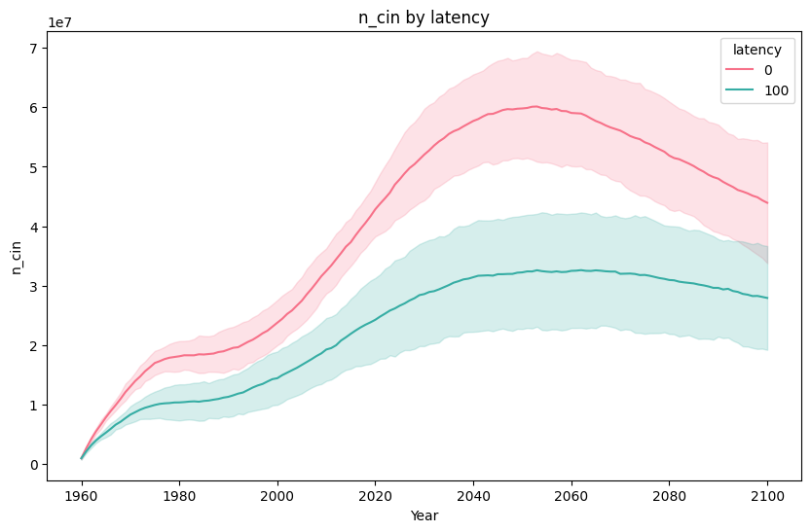
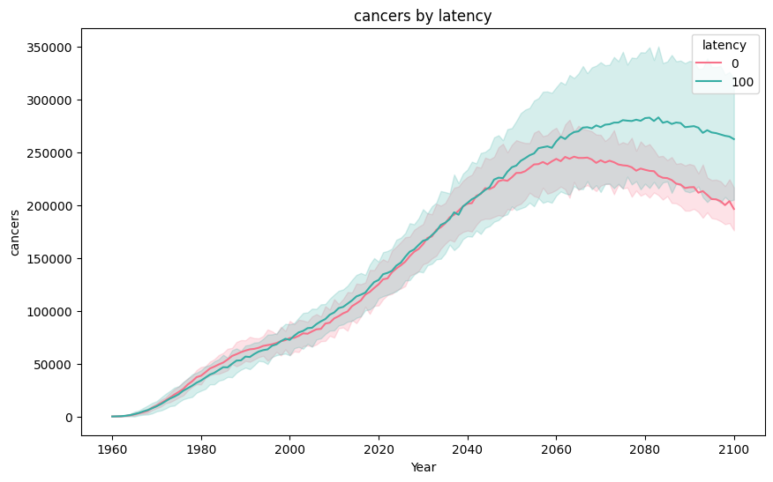
Disease progression without vaccination
100% latency is associated with
More infectious, more n_precin, but lower n_cin and more prolonged cancers

Slide 26
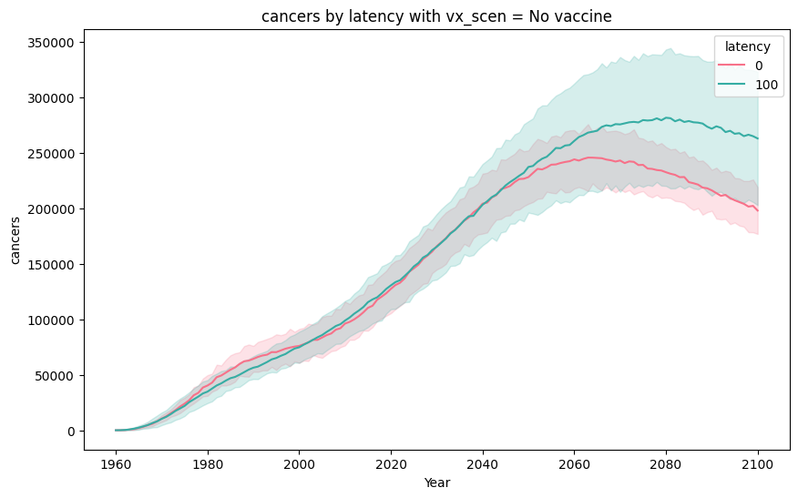
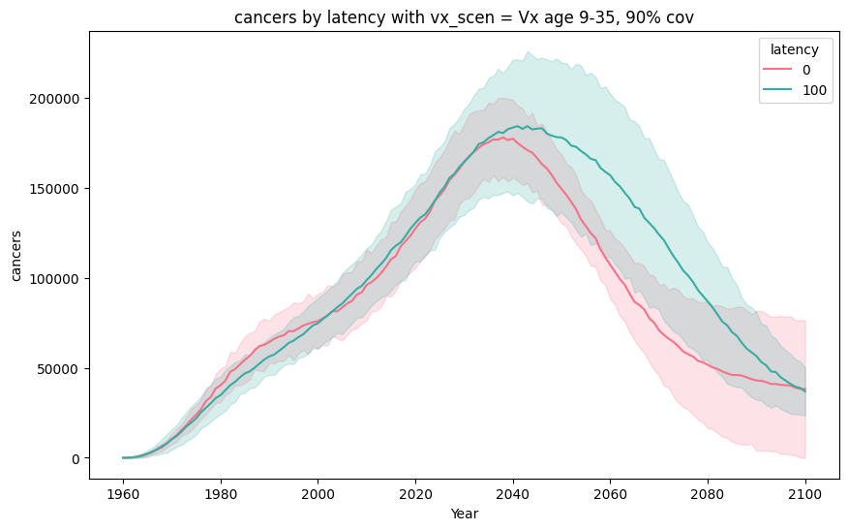
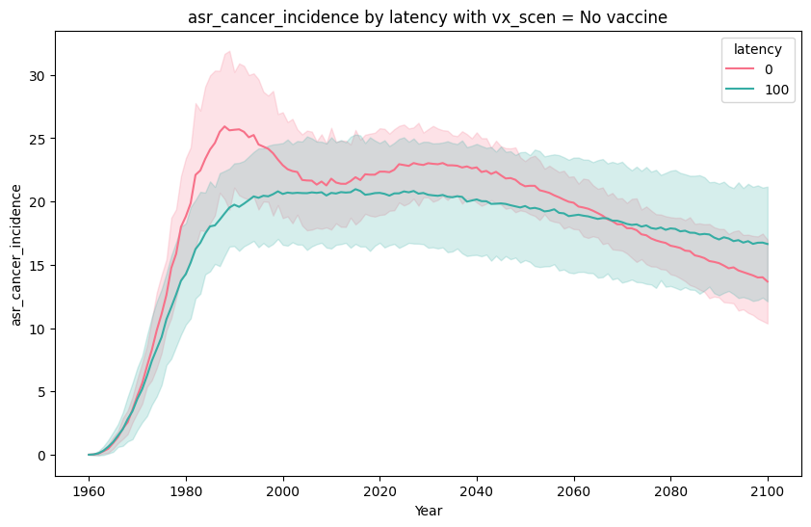
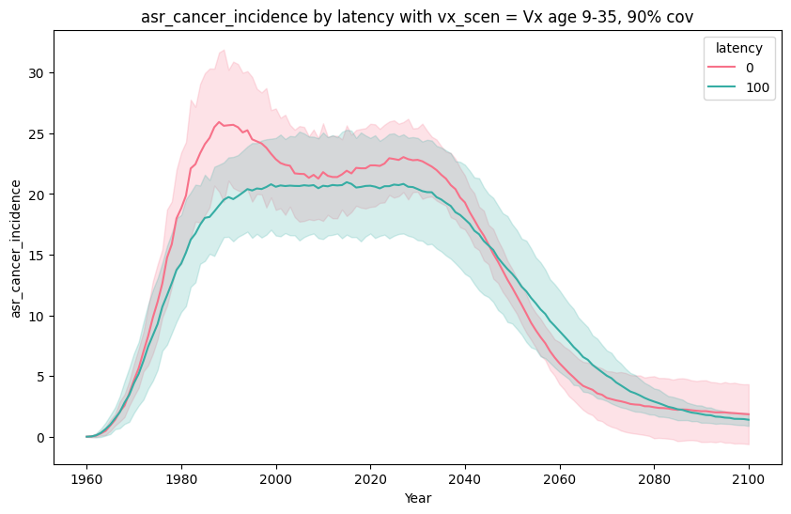
Policy outcomes with 0% vs. 100% latency
Without vaccination, 100% latency results has more cancers with later peak, maybe due to reactivated infections
With the most intervention,
0% latency decreases the cancer rate more instantly
Although 100% latency takes more time, cancer eventually diminishes
Baseline (No vaccine, 15% screening)
Most (vaccinate until 35)

Slide 27
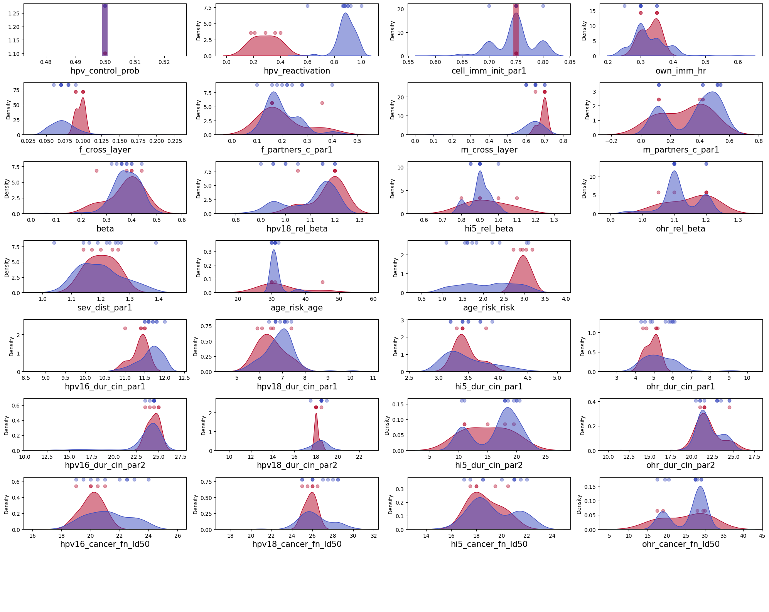
Adding 50% latency infection, split by hpv_reactivation
With low hpv_reactivation,
High f_cross_layer
High age_risk_risk to balance with less infections/more cancers
No significant differences in sev_dist and disease parameters
Would this different configuration impact policy outcomes?

Slide 28
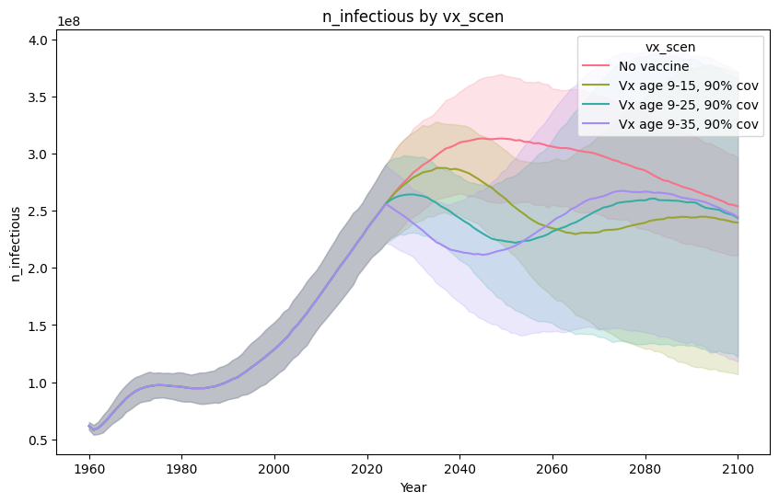
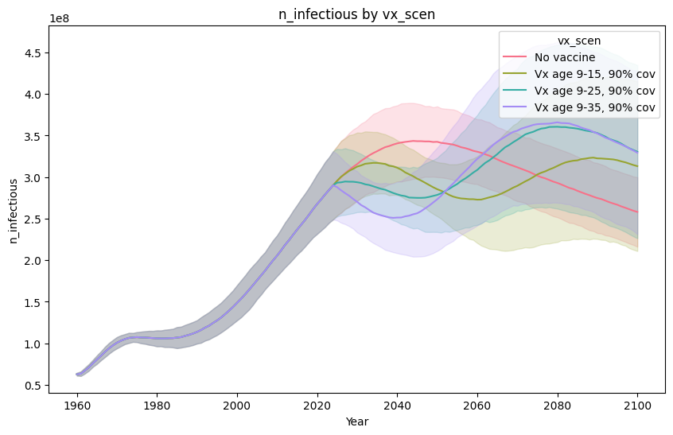
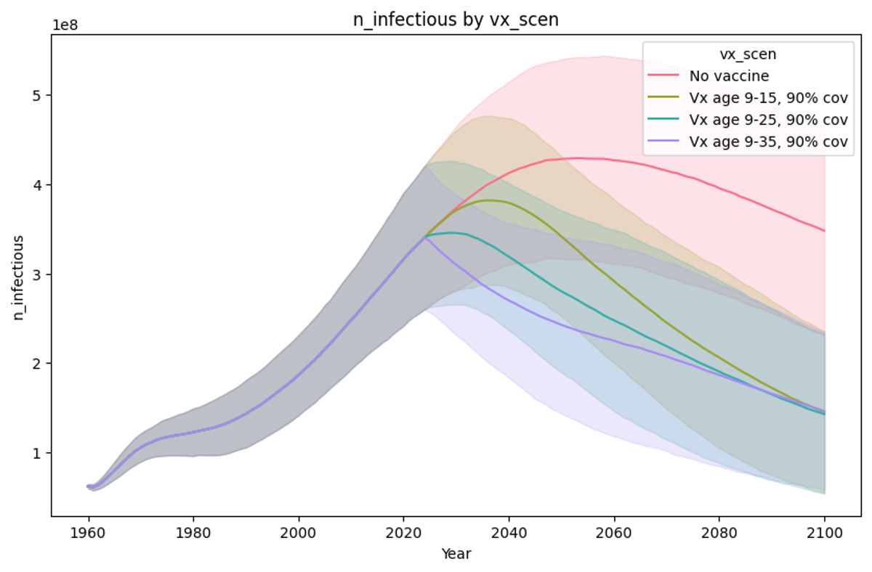
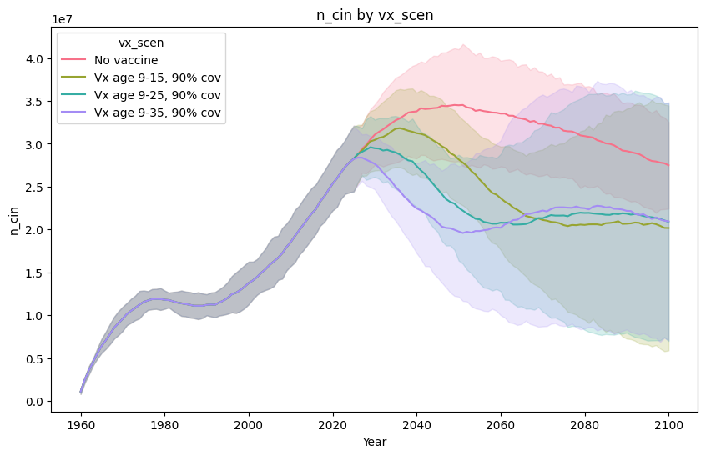
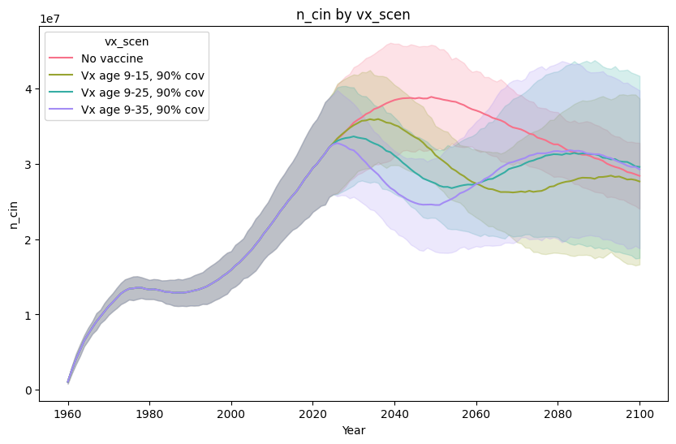
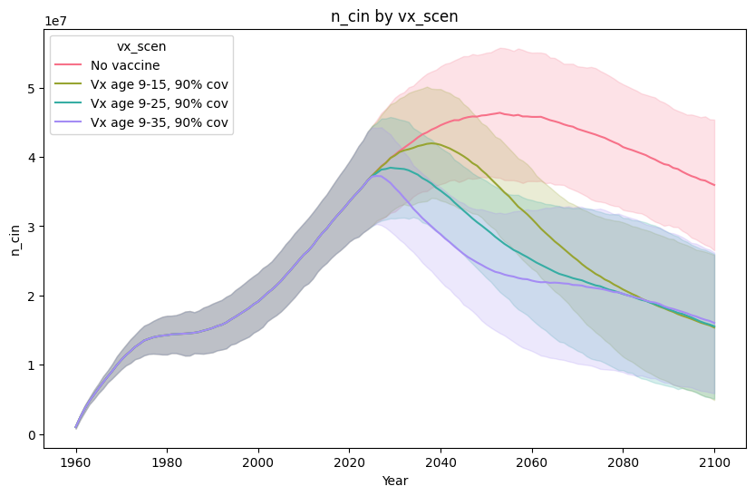
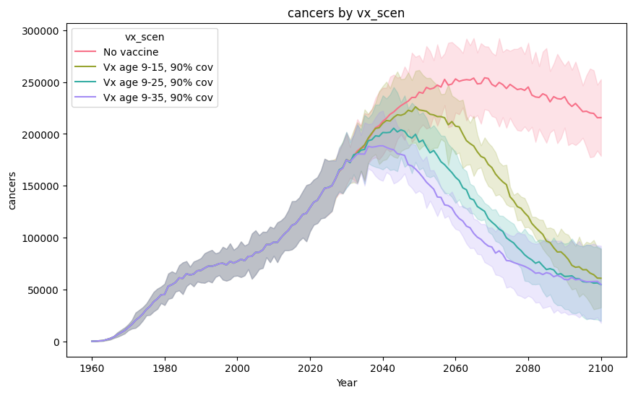
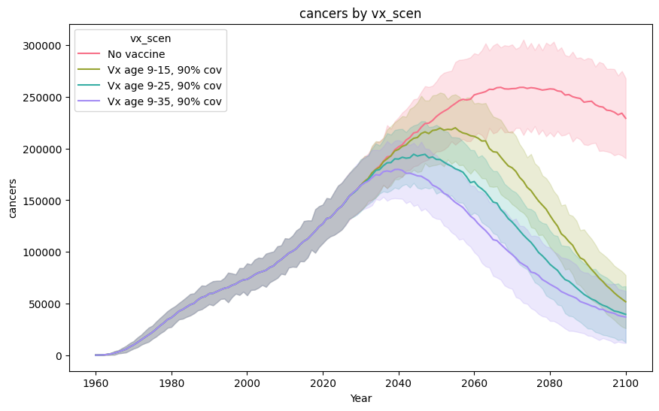

With vaccination, n_infectious and n_cin rehike due to high hpv_reactivation. This is not observed in 0%/100% latency as their reactivation level is very low
50% latency, low reactivation (0.18~0.4)
50% latency, high reactivation (0.6~1)
100% latency

Slide 29
Next steps – Policy questions and draft paper
Select parameter sets – top 100 or representative sets
Select scenarios from run_scenarios or others?
Affected by sexual behavior, latency, and immunity => PxV vaccine – expanding upper age of vaccine, going up to 25, 35, ….
With latency, cancers are caused by infections that acquired young -> vaccine won’t work with reactivated infection, only work with new infection. => Expect to lower benefits with expanded. E.g., Exposed at age 20, reactivated at age 30 that cause cancer, no clear infection during latent period.
With low latency, cancer might be caused by infection that was acquired => Expect to get higher benefits
Age of causal infection – preventable infection? Sexual acquisition = date exposed vs. Date reactivated.. With the same genotype, once exposed, does not get infected again. But with different genotype, may be coinfected. is independent.
With no latency, clear infection, get natural immunity, reduced chance of getting reinfected, but may be reinfected (including the same type)
With latency, during latent period, no chance of getting reinfected with the same type, but may be coinfected. No correlation with latent coinfection.
Current PxV setting: lifelong immunity
Draft the outline of paper
Consider including other countries
0-25% vs. 75-100%

Slide 30
sim.results list
infections | n_susceptible | n_infectious_by_age | new_vaccinated
infections_by_genotype | n_susceptible_by_genotype | n_females_infectious_by_age | new_total_vaccinated
infections_by_age | n_infectious | n_susceptible_by_age | cum_vaccinated
dysplasias | n_infectious_by_genotype | n_precin_by_age | cum_total_vaccinated
dysplasias_by_genotype | n_inactive | n_cin_by_age | new_doses
dysplasias_by_age | n_inactive_by_genotype | hpv_incidence | cum_doses
precins | n_normal | hpv_incidence_by_genotype | new_txvx_doses
precins_by_genotype | n_normal_by_genotype | hpv_incidence_by_age | new_tx_vaccinated
precins_by_age | n_cin | dysplasia_incidence | cum_txvx_doses
cins | n_cin_by_genotype | dysplasia_incidence_by_genotype | cum_tx_vaccinated
cins_by_genotype | n_cancerous | dysplasia_incidence_by_age | new_screens
cins_by_age | n_cancerous_by_genotype | cancer_incidence | new_screened
cancers | n_infected | cancer_incidence_by_genotype | new_cin_treatments
cancers_by_genotype | n_infected_by_genotype | cancer_incidence_by_age | new_cin_treated
cancers_by_age | n_abnormal | births | new_cancer_treatments
detected_cancers | n_abnormal_by_genotype | other_deaths | new_cancer_treated
detected_cancers_by_genotype | n_latent | migration | cum_screens
detected_cancers_by_age | n_latent_by_genotype | infections_by_sex | cum_screened
cancer_deaths | n_precin | other_deaths_by_sex | cum_cin_treatments
cancer_deaths_by_genotype | n_precin_by_genotype | asr_cancer_incidence | cum_cin_treated
cancer_deaths_by_age | n_detected_cancer | asr_cancer_mortality | cum_cancer_treatments
detected_cancer_deaths | n_detected_cancer_by_genotype | precin_genotype_dist | cum_cancer_treated
detected_cancer_deaths_by_genotype | n_screened | cin_genotype_dist | detected_cancer_incidence
detected_cancer_deaths_by_age | n_screened_by_genotype | cancerous_genotype_dist | cancer_mortality
reinfections | n_cin_treated | n_alive | hpv_prevalence
reinfections_by_genotype | n_cin_treated_by_genotype | n_alive_by_sex | hpv_prevalence_by_genotype
reinfections_by_age | n_cancer_treated | n_alive_by_age | hpv_prevalence_by_age
reactivations | n_cancer_treated_by_genotype | n_females_alive_by_age | precin_prevalence
reactivations_by_genotype | n_vaccinated | cdr | precin_prevalence_by_genotype
reactivations_by_age | n_vaccinated_by_genotype | cbr | precin_prevalence_by_age
 | n_tx_vaccinated |  | cin_prevalence
 | n_tx_vaccinated_by_genotype |  | cin_prevalence_by_genotype
 |  |  | cin_prevalence_by_age
 |  |  | female_hpv_prevalence_by_age
 |  |  | lsil_prevalence
 |  |  | lsil_prevalence_by_age
 |  |  | year
 |  |  | t

